Slide 1


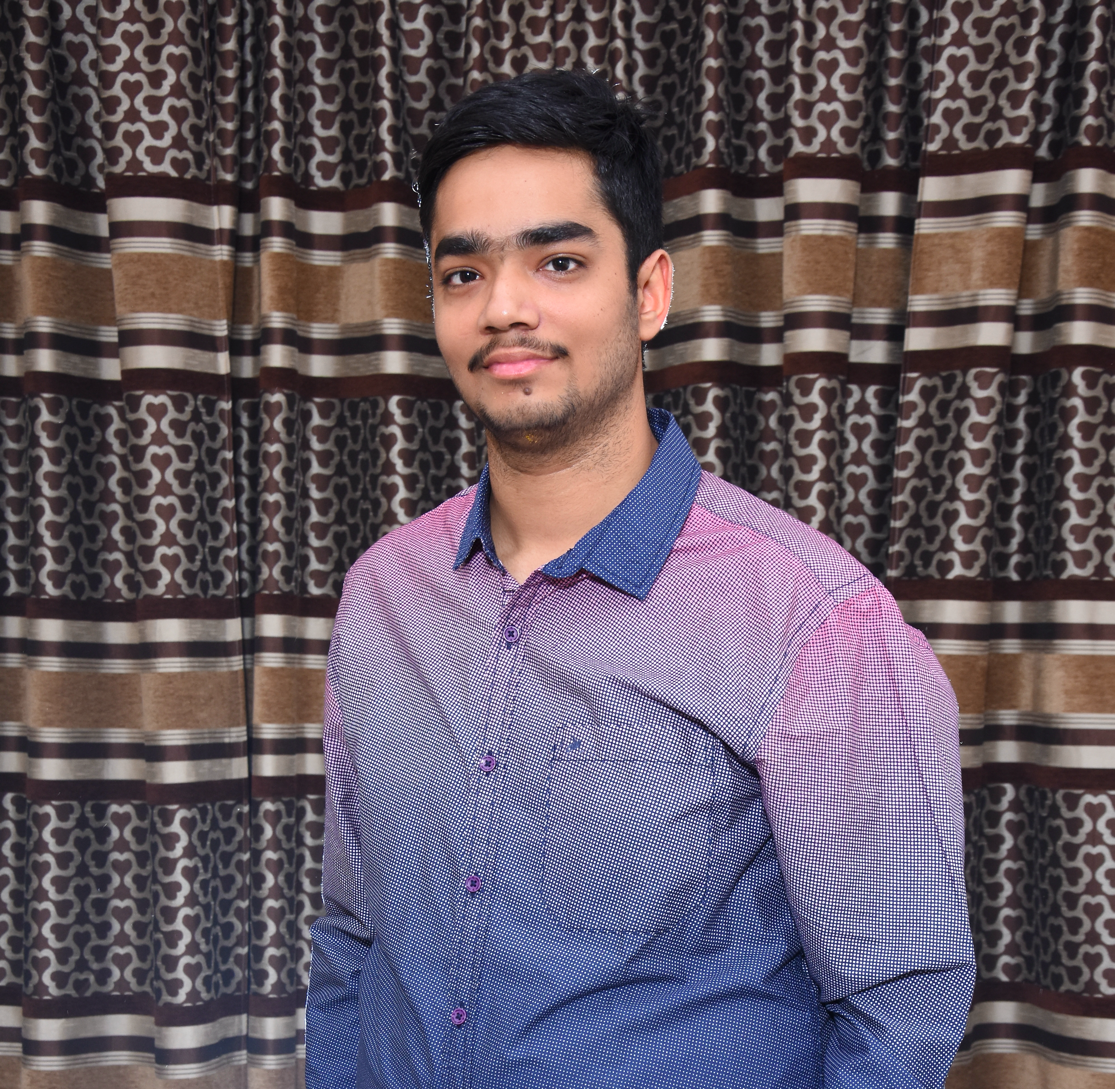















AADHAR
BHATNAGAR
@reactninja @aadhario @aadhar54
Education :
Experience :

Slide 2



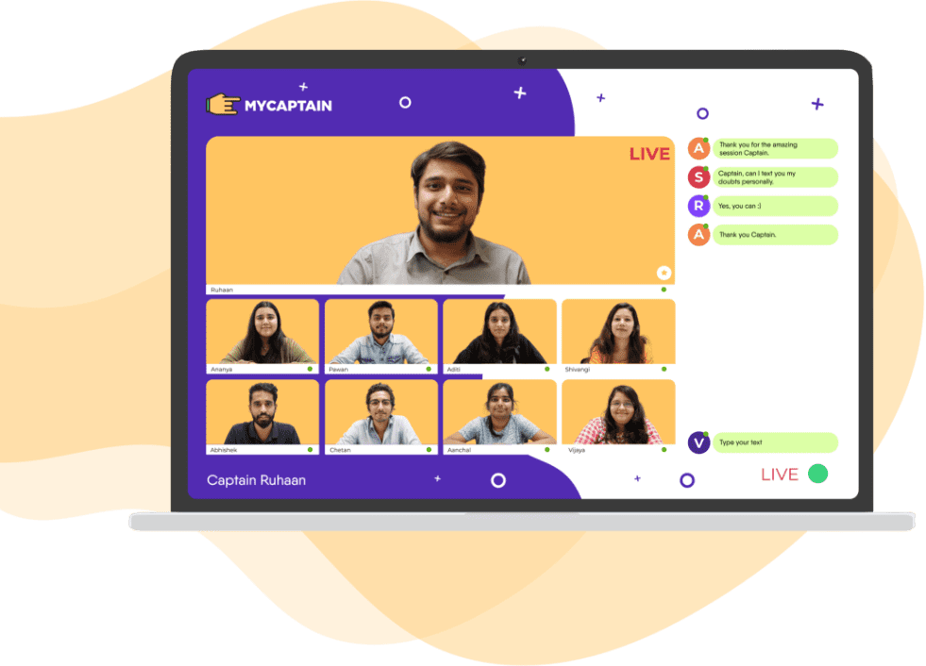
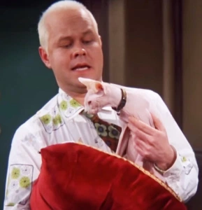
-

Slide 3
Purpose of the workshop : Code your heart out !
Develop logic and problem solving skills from SCRATCH
Understand that coding is much more than syntax
Practice and understand coding topics in a well defined sequence
Fall in ❤️ with Computer science and
Learn to use git and github efficiently
Become ready for open source contributions and hackathons

Slide 4
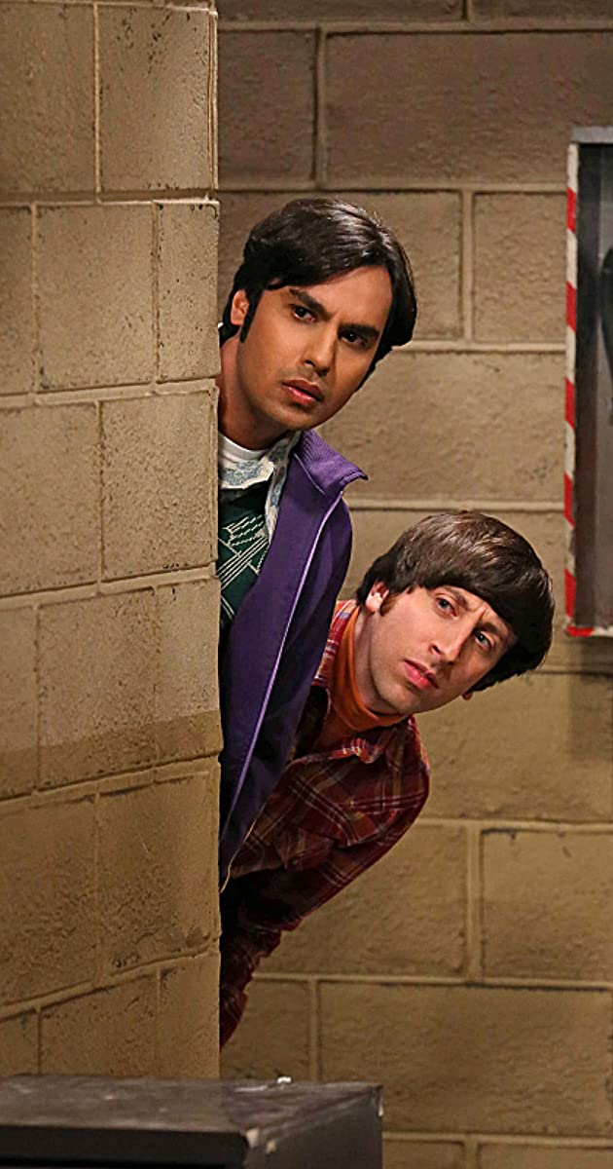
Success in the Workshop
Complete all the module ( videos and questions ) submissions in the My Captain Mobile Application.
Practice , Ask Doubts and Help others in the contest.
Complete the quizes , homework , discussed code files given before the next live session.
Be happy and get ready to have a super awesome month .

Slide 5

Essentials for a software developer (Sarcastic)
-Apple devices
-AI Machine Learning Enthusiast in linkedin -Showoff swags and Tshirts in Instagram
-Must know how to hack Facebook
-Should have binge watched Silicon Valley , Mr. Robot.

Slide 6
Essentials for a software developer (Real)
-must have profiles on linkedin , github and any CP platform
-must know version control (Git and Github)
-must be a problem solver at ❤️ rather than language specific
-must have a portfolio http://devaadharcv.netlify.app/
-must participate in Opensource programs and Hackathons
-must have good basics of Data Structures , OS , DBMS

Slide 7
Workshop Details :
Asking doubts using online compiler http://ide.geeksforgeeks.org/
Ide's for the course DevC++ / CodeBlocks / VS Code / Xcode / TurboC++
Bonus Documents
Course Github Repository https://github.com/aadhar54/July2020
Gunther Can Code https://github.com/aadhar54/Gunther-Can-Code
Live Session Days Wednesday & Friday
Projects in the course
Submissions (Github) https://www.youtube.com/watch?v=nhNq2kIvi9s
How to get certificates and Lor Submit the Projects and questions in the MyCaptain Mobile Application

Slide 8

Head over to this link to meet Phoebe ….
https://docs.google.com/document/d/1KeXDCt84xaGoU6NaUGKk-rih3bhc2yDakTkRk_tvt4M/edit?usp=sharing

